Slide 1
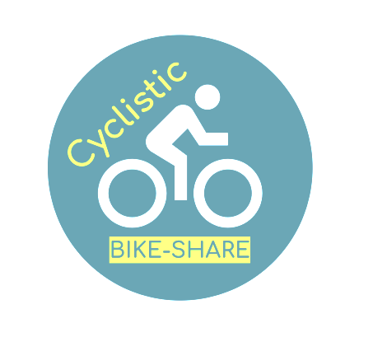

Cyclistic bike-share analysis case study
Case Study: How Does a Bike-Share Navigate Speedy Success?
Sumit Dattu Beldar

Slide 2
Phases
Ask
Study the pattern of annual member and non-member riders to define the marketing strategy of bringing the non-member into the member program. The following three questions would help in directing the future marketing Program.
How do annual members and casual riders use Cyclistic bikes differently?
Why would casual riders buy Cyclistic annual memberships?
How can Cyclistic use digital media to influence casual riders to become members?
Tool followed:- Excel(Power-Pivot & Power Query), R, and SQL
Prepare
Data set obtained from the link
Data set from Quarter # 2 of 2019 to Quarter # 1 of 2020 were downloaded from the link and stored on the local desktop.
Process
Following steps were performed in the R platform, and the final file was extracted for final analysis
Made the columns’ name uniform across the file
Before merging the files, remove any extra columns that are not common to all files.
Merge the column into one file using the full outer join
Rename the row from Subscriber/member to Member and Customer / casual to Non-Member
Identified the outliers and recorded outliers in a separate column as “Outliers.”
Extracted the file as CSV, and the same file was used for the analysis
The file was ready to use for the analysis.

Slide 3
Phases- Analyse
Pre-Data analysis:- we created the following columns
Ride Length in Minutes – This was done by subtracting the ride’s start time from to end time.
Weekday – calculated from the start time column
Day name – calculated from the start time column
Day number – calculated from the start time column
Similar way Month number, month name and quarters were created

Slide 4
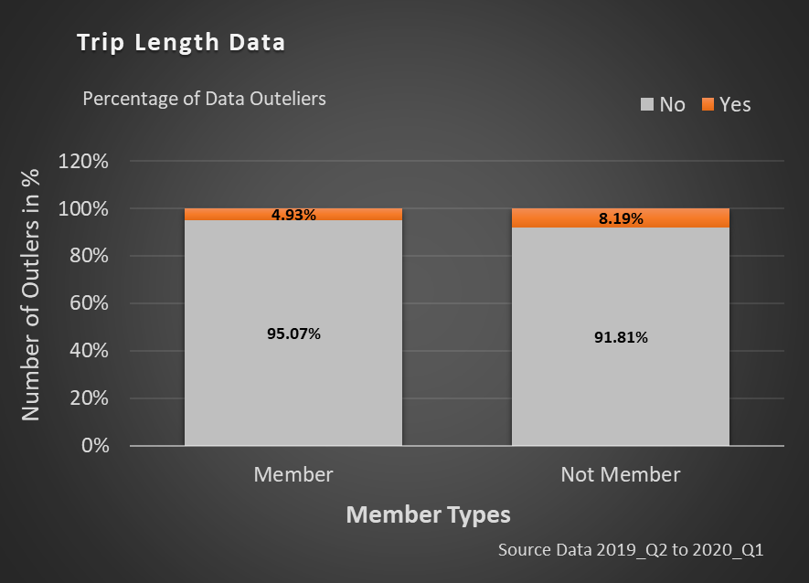
Identify Data Outliers
Total
Total number of Data is 38,79,599.00
Members
Total amount of Data from the Members is 29,73,861
Non-Members
Total amount of data from the non-members is 4,52,869
Outliers
Total outliers from the members are 4.93%, while 8.19% are observed in the non-members.

Slide 5
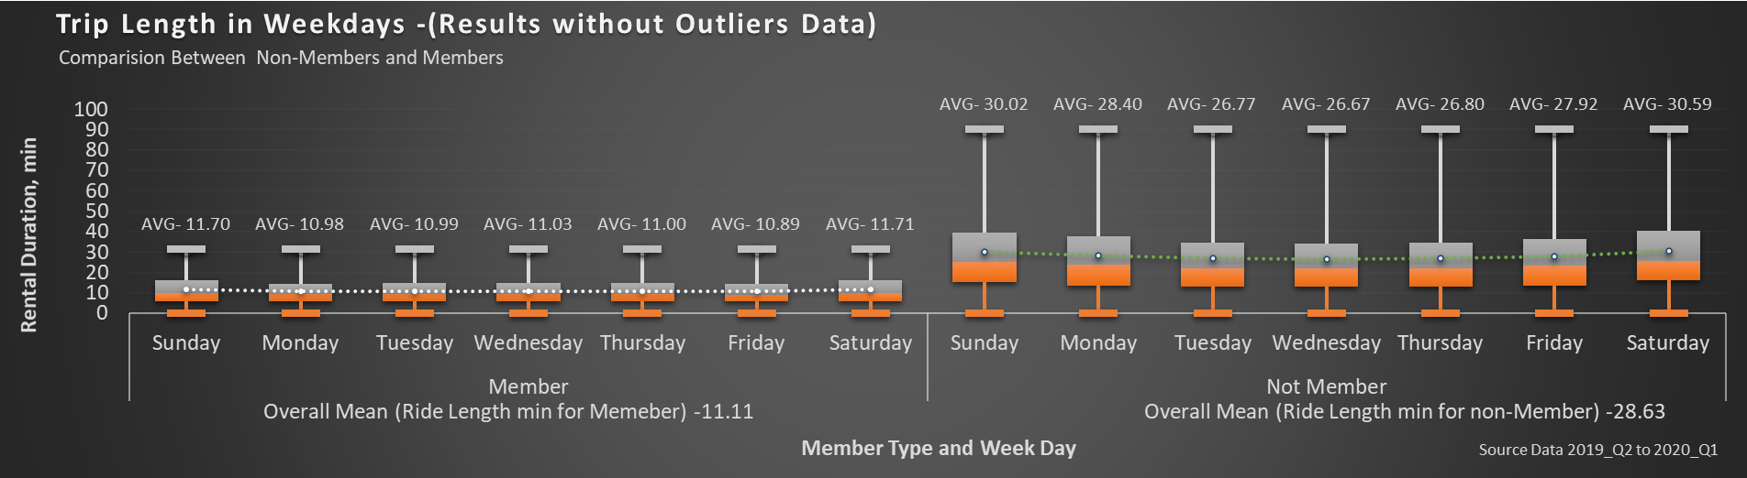
Trip Length in Weekdays
Mean trip length was lowered with members compared to non-members.
Interestingly, the mean trip length was 3 minutes higher on the weekend with the non-members when the weekend data is compared with Monday to Friday data of the same group.
There is no significant difference in mean ride value observed within members of weekdays data.

Slide 6
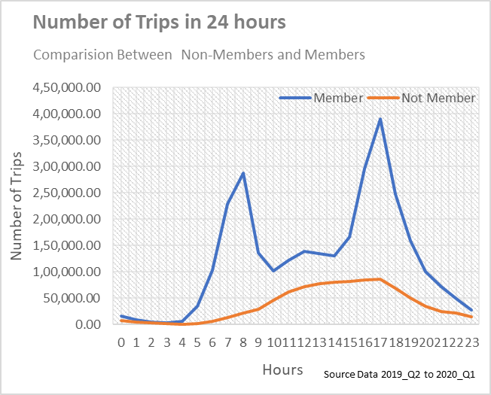
Number of Trips in 24 hours
Members
The number of trips increases sharply from 4 to 7:30 am and deceased from 7:30 to 10 am.
Further, the number of trips slightly increased to noon and decreased till 2 pm.
After 3 pm, a sharp increase in the number of trips is observed till 6 pm.
Non-Members
The number of trips gradually increases from 6 am until 5 pm.
Slowly, the number of trips drops after 5 pm.
Compared with the Member group, the number of trips of the non-member group is significantly lowered from 4 am to 10 pm.

Slide 7
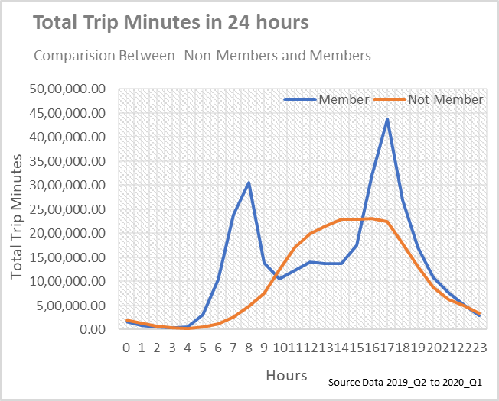
Total Rides in Minutes in 24 hours
Members
The total number of trips and the pattern of full trips minutes in 24 hours are identical.
Non-Members
Similarly, the total number of trips and full trips in 24 hours are identical.
However, the total minutes of trips utilized by a non-member are higher from 10 am to 3 pm than the member.
Based on the study, we could say that most of the members are likely from employee groups working in shifts.

Slide 8
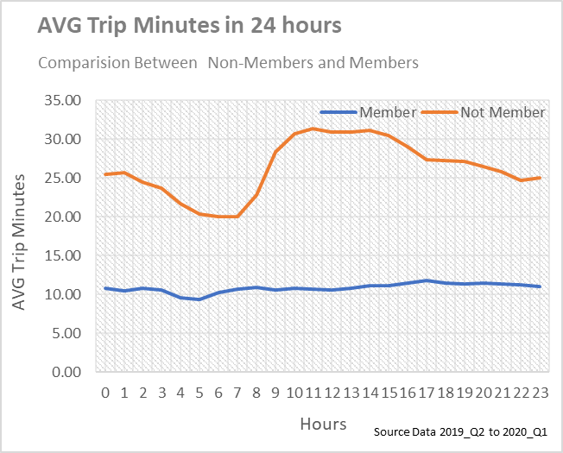
Mean Trip Minutes in 24 hours
Members
Mean trip time of member is in range of approximately from 9 to 11 thought the day.
Non-Members
The mean trip time of non-member is deceased from 12 midnight to 6 am.
The sharp increase in mean trip time is observed after 7 am till 11 am. It remains steady till 2 pm and gradually decreases till 10 pm and slight increases after 10 pm.
Overall, mean ride time is higher by approximately two times with non-members compared with members.
We will further deep-dive on the number of trips at various stations between members and non-members.

Slide 9
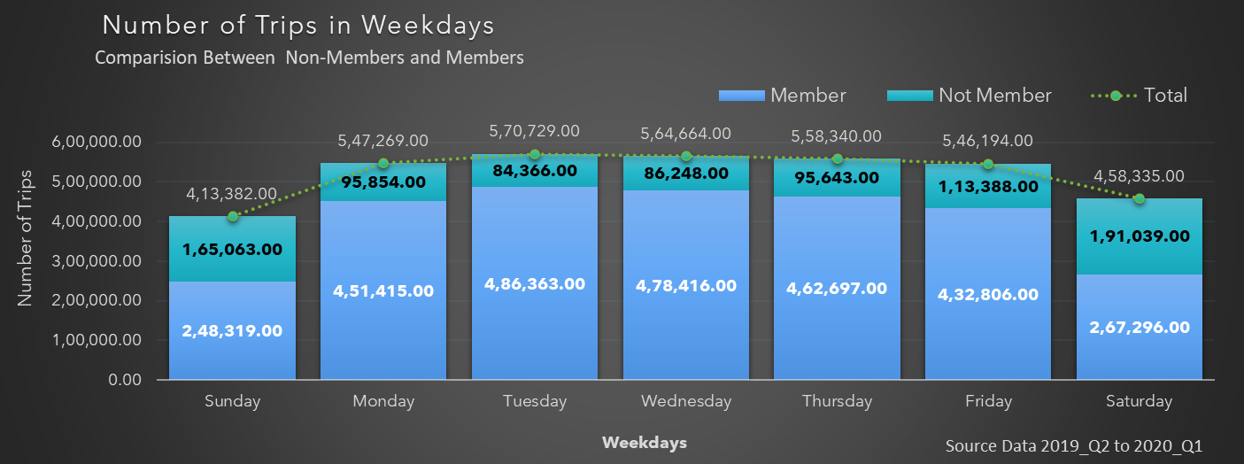
Number of Trips in Weekdays
Members
The number of trips was reduced by approximately more than half from members on weekends compared to Monday to Friday.
The number of members’ trips was increased from Monday, reached optimum on Wednesday, and slightly decreased from Wednesday.
Non-Members
The number of trips was approximately 1.5 to 2.0 times higher on weekends than Monday-Friday.
The number of non-members’ trips was higher on Friday followed by Monday other than weekends.

Slide 10
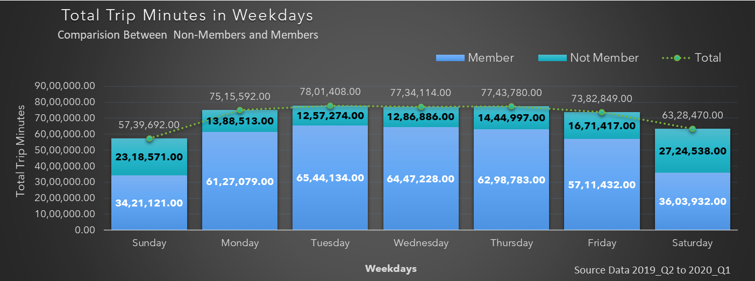
Total Rides Minutes in Weekdays
Members
The maximum number of rides in minutes was higher on Tuesday and reduced gradually after Tuesday.
The lowest was on Sunday followed by Saturday.
Non-Members
The maximum number of rides in minutes was higher on Saturday, followed by Sunday and Friday.
The ride utilization was observed higher on Friday, Saturday, and Sunday.

Slide 11
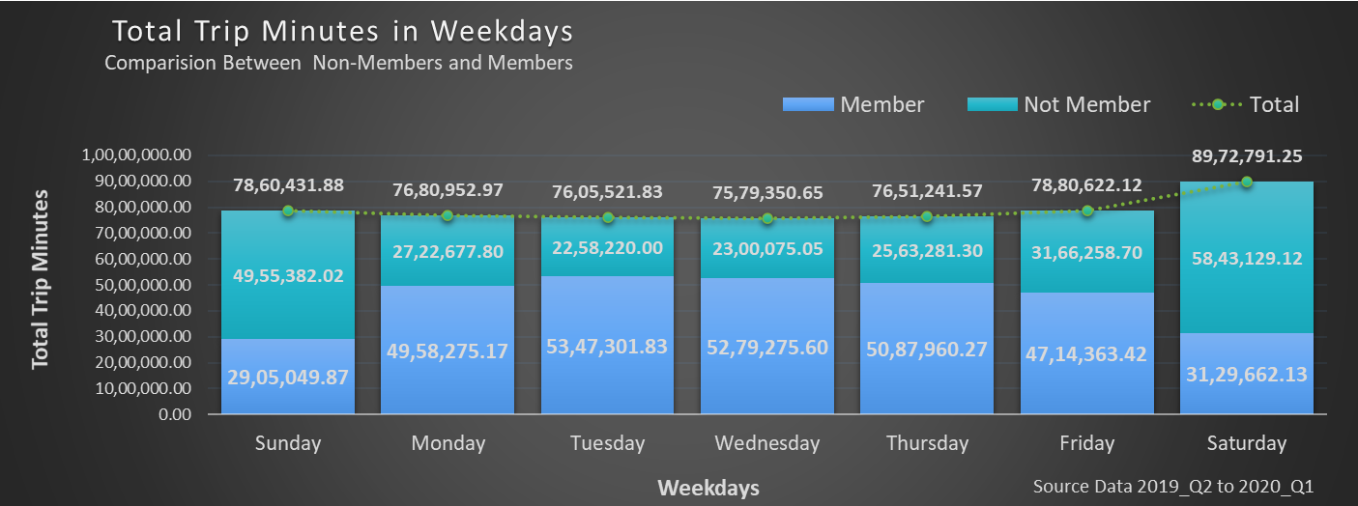
Mean Trip Minutes in Weekdays
Members
The mean trip ride in minutes is approximately two times lower than non-members.
Though the number of trips lowered on weekends, the average trips time is approximately higher by 1 minute.
Non-Members
The mean trip ride in minutes is higher on Saturday and Sunday, followed by Monday and Friday.
Though the number of trips lowered compared with members, the average trip time in minutes is two times higher.

Slide 12
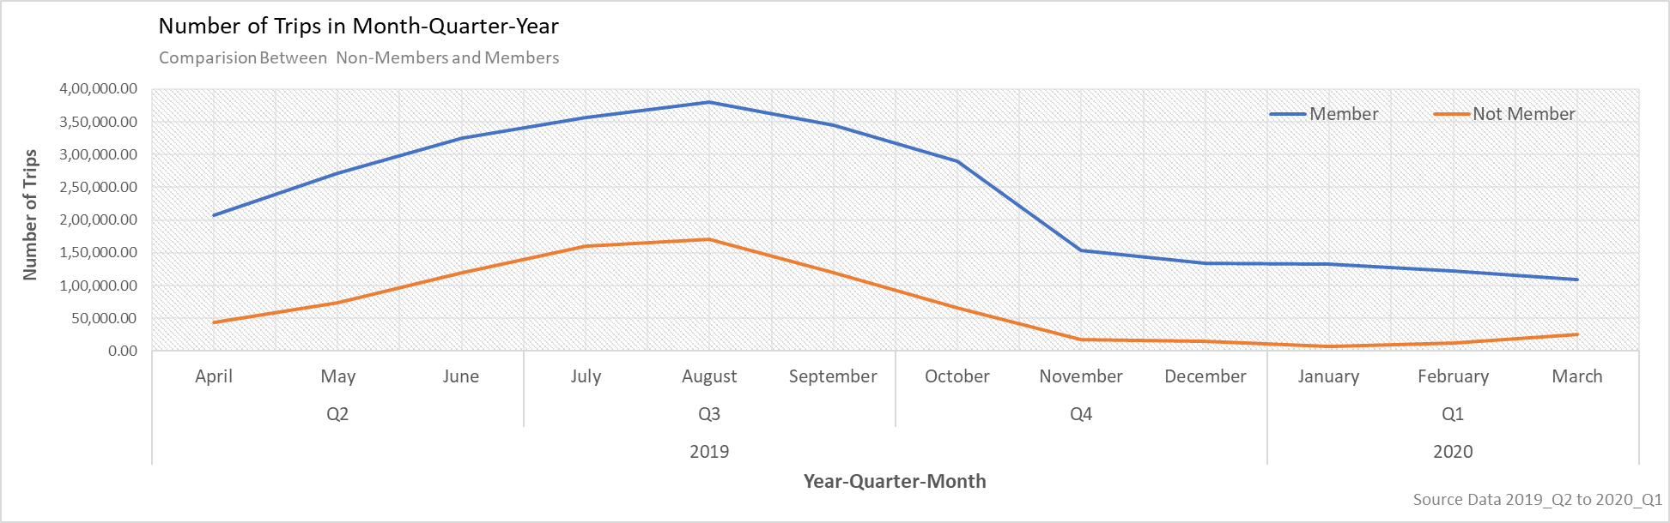
Number of Trips in Year-Quarter-Month
Apr. 2019
The number of trips for both members and non-members increased from April 2019 and peaked in July 2019.
Aug. 2019
After Aug 2019, it showed decreasing trend till November. It remained steady till Feb 2020 in the cased of members, and for non-members, it was March 2020.
Oct. 2019
The trend of non-members was steep declined compared to members. The same pattern in members was observed after Oct 2019, which remained until Nov 2019.

Slide 13
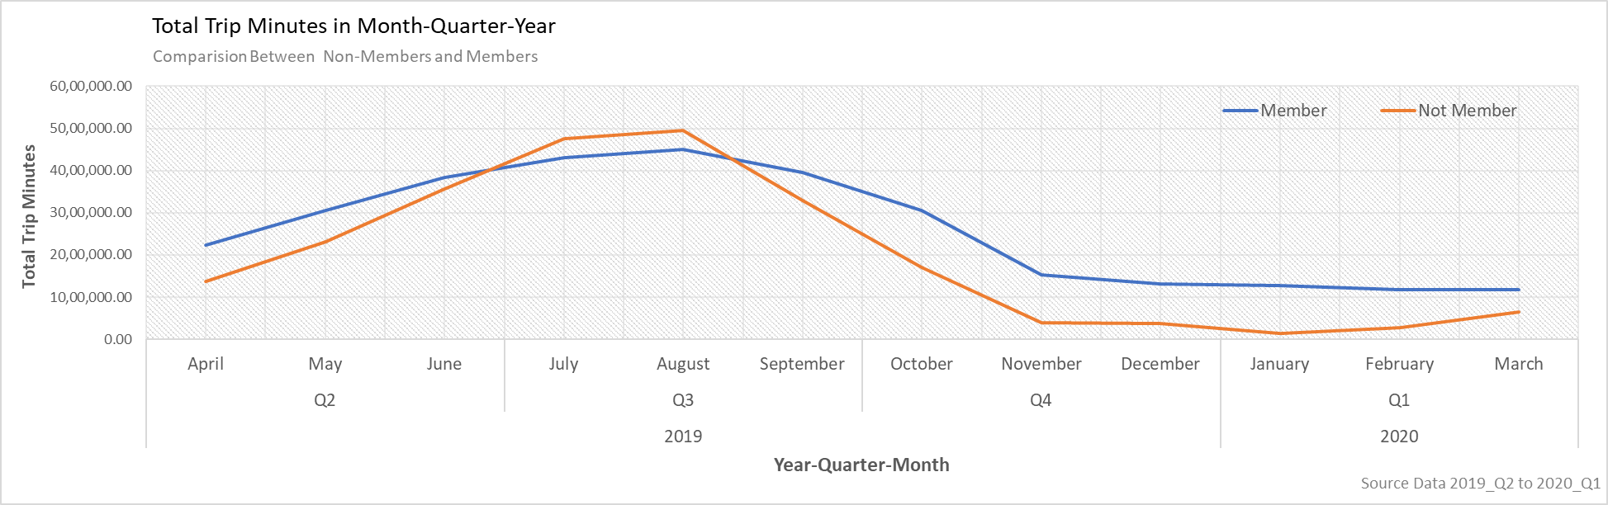
Total Rides in Minutes in Year-Quarter- Month
Members
A similar pattern for members was observed for total ride time in minutes as we followed the way in the total number of rides.
The ride time minutes reduced gradually from Aug 2019 till the end of September 2019. From September 2019, it was a steep decrease in total ride time till the end of Oct 2019. slightly decreased in whole ride minutes observed from November 2019 and remained steady from February to March 2020.
Non-Members
There is a slight increase in ride time (minutes) from November- to December 2019. The ride time minutes was again increased from Feb 2019.
There is a slight increase in the total ride time (minutes) from November- to December 2019. This ride time (minutes) increased again from Feb 2019.

Slide 14
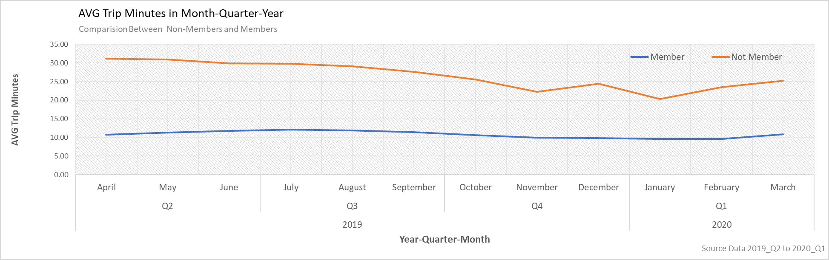
Mean Trip Minutes in Year-Quarter- Month
Members
Mean ride time (minutes) increases from April 2019 until September 2019. It remained steady from October 2019 till February 2020.
The mean trip time (minutes) is slightly raised from mid-Feb 2020.
Non-Members
The mean ride time (minutes) slightly decreases from April 2019 until the mid of July 2019. The mean ride time reduction was comparatively higher from August 2019 until October 2019.
The mean ride time increased in November 2019, decreased in December 2019, and raised from January 2020 onward.

Slide 15
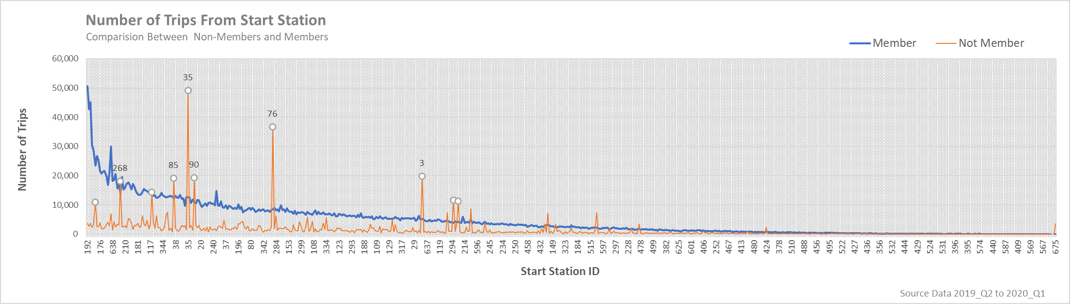
Number of Trips From Start Station
The number of trips from non-members was higher at start station ID [Name] “compared to the members.”
90 [Millennium Park]
268 [Lake Shore Dr & North Blvd]
3 [Shedd Aquarium]
35 [Streeter Dr & Grand Ave]
76 [Lake Shore Dr & Monroe St]
85 [Michigan Ave & Oak St]

Slide 16
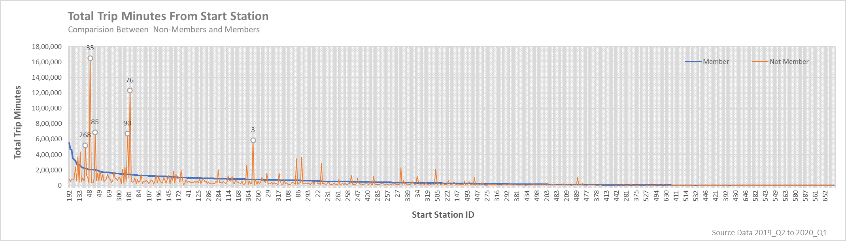
Total Trip in Minutes From Start Station
The whole trip in minutes from non-members was higher at start station ID [Name]
“compared to the members.”
35 [Streeter Dr & Grand Ave],
76 [Lake Shore Dr & Monroe St],
85 [Michigan Ave & Oak St],
90 [Millennium Park],
3 [Shedd Aquarium]
268 [Lake Shore Dr & North Blvd]

Slide 17
ACT Phase
knitr
To increase the number of rides for short, long duration and encourage the non-member into a membership program. These are:
Members observed two picks from 6 am to 7 am and 3 pm to 5 pm. Most of the members are employees used for their respective office or factory commute. The rides time is concise duration. The non-member used rides from 9 am to 5 pm. The mean ride is higher, indicating that the non-members drive for a more extended period. We could encourage them to give a discount or coupon for the shorter rides by employing the membership program.
The number of rides from the member is reduced by half on Saturday and Sunday. It would be given a discount or promotion to the member on these days to increase the number of rides.
June and July are the picks in the rides for both members and non-members. June and July periods are for student vacations. We need to have discounts and promotions for this specific period to increase the trips and convert the non-member into a membership program.
November and December are Christmas time, and rides increase for non-members discount or promotion package is an excellent idea to increase the rides.
The trips rides from non-members are larger from station id [Name]; 35 [Streeter Dr & Grand Ave], 76 [Lake Shore Dr & Monroe St], 85 [Michigan Ave & Oak St], 90 [Millennium Park], 3 [Shedd Aquarium]. The marketing team must focus on these stations to bring a non-member to membership and more promotions.

